Slide 1
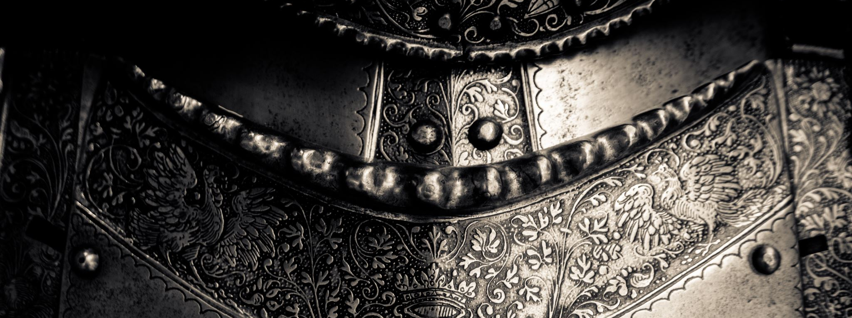
Ancient of Days
CCLI

Slide 2
Verse 1
Though the nations rage, kingdoms rise and fall
There is still one King reigning over all
So I will not fear for this truth remains:
That my God is, the Ancient of Days

Slide 3
Chorus
None above Him, none before Him
All of time in His hands
For His throne it shall remain and ever stand

Slide 4
Chorus
All the power, all the glory
I will trust in His name
For my God is, the Ancient of Days

Slide 5
Verse 2
Though the dread of night overwhelms my soul
He is here with me, I am not alone
O His love is sure, and He knows my name
For my God is, the Ancient of Days

Slide 6
Chorus
None above Him, none before Him
All of time in His hands
For His throne it shall remain and ever stand

Slide 7
Chorus
All the power, all the glory
I will trust in His name
For my God is, the Ancient of Days

Slide 8
Bridge
Though I may not see what the future brings
I will watch and wait for the Saviour King
Then my joy complete standing face to face
In the presence of the Ancient of Days

Slide 9
Chorus
None above Him, none before Him
All of time in His hands
For His throne it shall remain and ever stand

Slide 10
Chorus
All the power, all the glory
I will trust in His name
For my God is, the Ancient of Days

Slide 11
Tag
For my God is, the Ancient of Days

